Slide 1

Computational Neuroscience, Neurotechnology and Neuro-inspired Artificial Intelligence (ISRC-CN3) Building Reliable and Secure Embedded Systems with Neuromorphic Computing
Jim Harkin
Intelligent Systems Research Centre
Ulster University, Magee Campus, Co. Derry

Slide 2
Content
Reliability Challenge
Brain-inspired Hardware
Brain-inspired Information Processing
Reliability via Self-repair (the concept)
Building Self-repairing Hardware
On-chip Communication Challenge and NoC Solution
The Opportunities

Slide 3
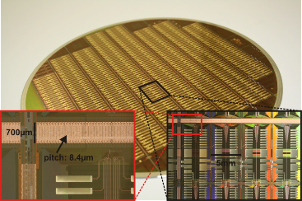

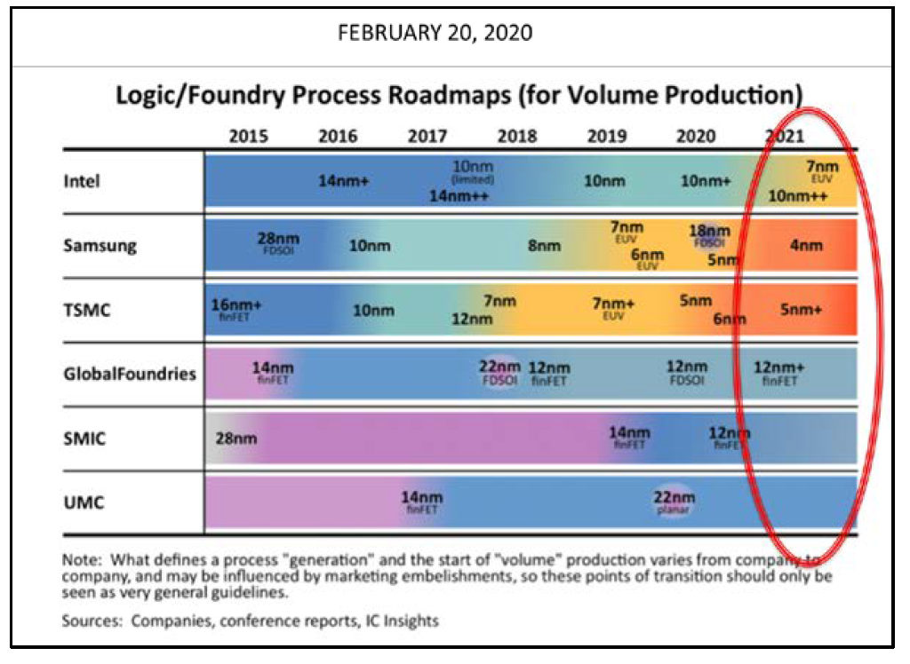
Motivation
Reliability is a significant challenge for modern electronic systems.
Increased physical defects in advanced silicon manufacturing processes; wear-out faults etc. Permanent, Temp. (SEU, Electromagnetic Interference)
“With device feature sizes projected to decrease to less than 5 nm within the next 10 years, scaling as we know it is expected to soon reach its physical limits or get to a point where cost and reliability issues far outweigh the benefits.”
IEEE International Roadmap for Devices and Systems (IRDS), 2020
IEEE International Roadmap for Devices and Systems (IRDS), 2020

Slide 4
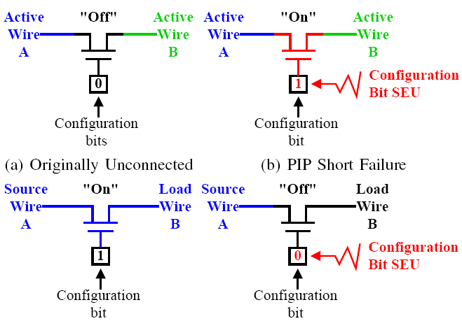
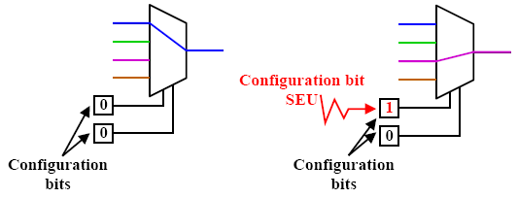
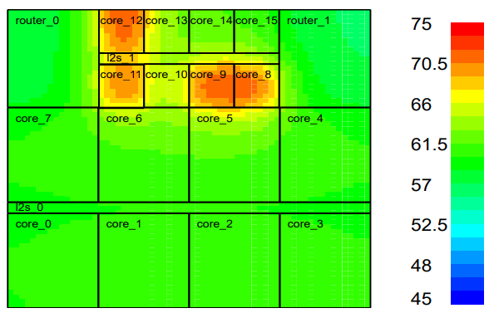
Electronic Faults
Faults can be transient (disappear after a relatively short time), intermittent (cycle between events) or permanent (always present).
Shrinking feature size
Increasing number of faults manifesting post fabrication
Wear-out faults
Failure due to Aging
Need for fault-tolerance or self-correcting strategies.
Transistor charge perturbed
MEAN time between failures (MTBF)
Multiplexer select lines can get corrupted
Thermal overstress
Excess heat— melts materials, warps and breaks semiconductor dies.
Electrical overstress
High voltage transient at base can damage transistor creating a base-emitter short circuit.
M. Ansari et al., IEEE Transactions on Emerging Topics in Computing 2021

Slide 5
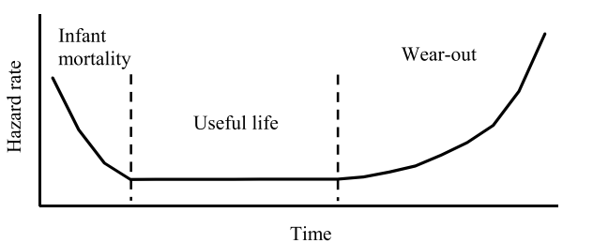
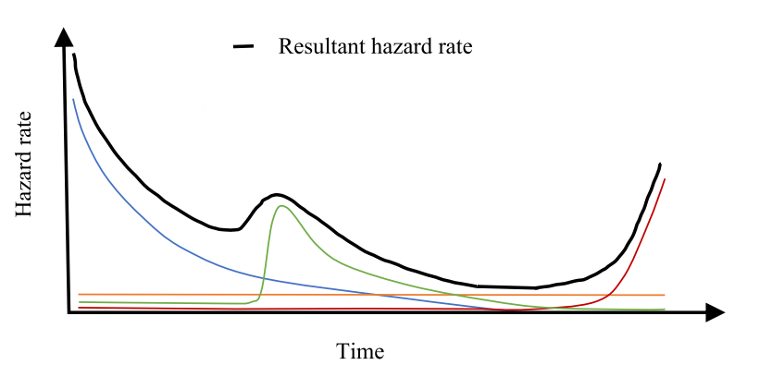
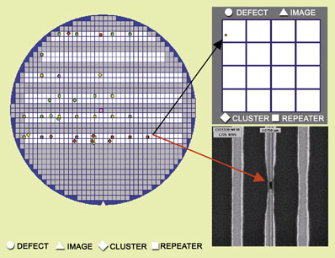
Electronic Faults
Bathtub model of hazard rate
Roller-coaster curve of the hazard rate
A. Gaonkar, et al., "An Assessment of Validity of the Bathtub Model Hazard Rate Trends in Electronics," in IEEE Access, vol. 9, pp. 10282-10290, 2021
Source: Adrian Stoica, NASA
Source: Adrian Stoica, NASA

Slide 6
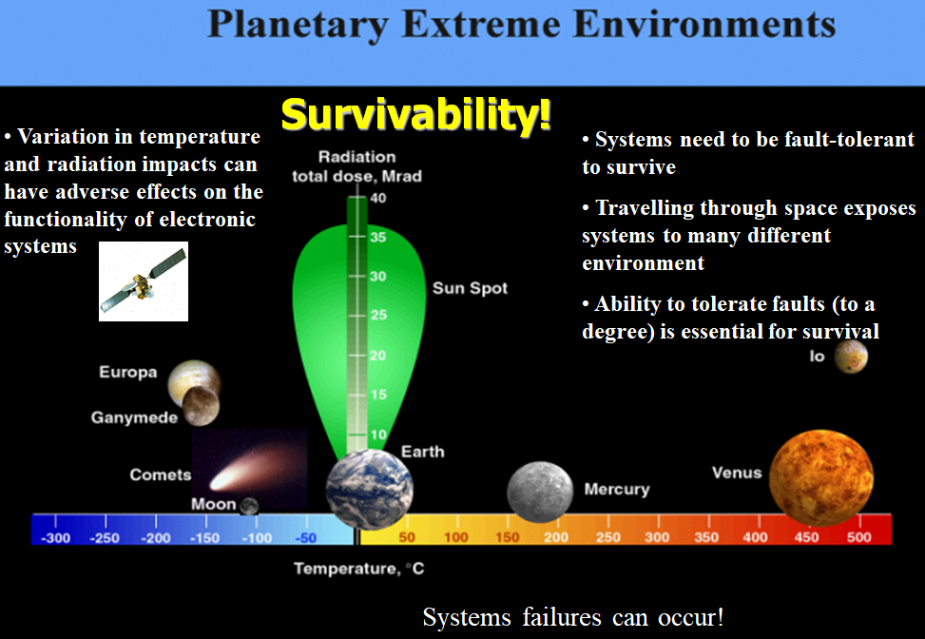
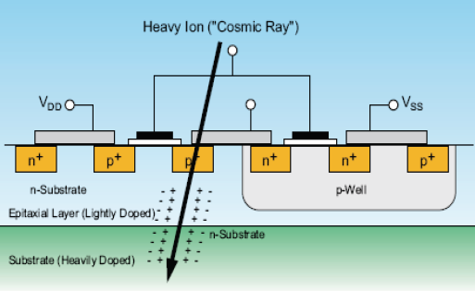
Electronic Faults
Bathtub model of hazard rate
Roller-coaster curve of the hazard rate
A. Gaonkar, et al., "An Assessment of Validity of the Bathtub Model Hazard Rate Trends in Electronics," in IEEE Access, vol. 9, pp. 10282-10290, 2021
http://www.spaceweather.com/
Source: Adrian Stoica, NASA
Exposure to radiation can cause SEU
Source: Adrian Stoica, NASA

Slide 7
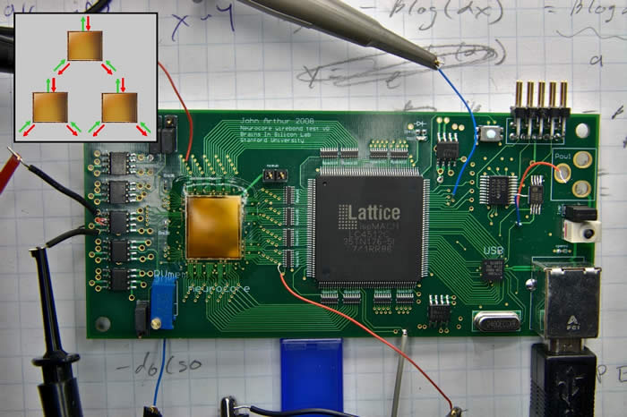
Self-X
self-monitor
self-detect
self-repair
Self-X
Traditional approaches: redundancy/replication models, error correction techniques, radiation hardening, Evolutionary/reconfigurable.
Limited levels of reliability – constraints on:
number of faults that can be tolerated (degree)
level of granularity with which repairs can be implemented
Often a central repair mechanism not distributed, therefore fault-prone

Slide 8
Operation of Fault Tolerant Systems
There are several key areas in the development of fault tolerant hardware computing systems:
Fault monitoring/detecting
- be able to detect a fault has occurred
Fault test and diagnostics
- where the fault is located
- the type of fault (transient, temporary or permanent)
Fault tolerant decision
- what can be done to restore the system’s operation, i.e. how can the fault be tolerated.
No
Monitor
Yes
Fault detected
Test
Yes
Yes
Diagnostics
Not completed
Yes
Fault diagnosis made
Decision
Decision made on restoration

Slide 9
Mitigating Hardware Faults
There are several further strategies to mitigating faults:
Fault tolerant hardening
- Fault tolerant redundancy (dynamic)
Fault tolerant replication (static)
Three main redundancy techniques used to creating fault-tolerant (FT) systems:
- Hot Standby
- Cold Standby
- Warm Standby

Slide 10
FT Redundancy : Hot Standby
Data in
Required: Complete Synchronization between the active and the backup components.
(Duplication of component A)
Active (primary)
A
A
Backup
Efficient and quick response time of the backup module
The strict synchronization requirement creates an overhead, i.e. wastage of resources.
The backup also has to be online with the primary.
Israel Koren, C. Mani Krishna, "Fault-Tolerant Systems", MK 2010

Slide 11
FT Redundancy : Cold Standby
The active component receives the incoming traffic updating the
internal state changes to a
reliable storage medium.
Only when the active fails is the backup updated with the state information.
Storage
Active (primary)
State updates
A
A
Backup
(secondary)
(Duplication of component A)
The solution is not synchronous.
It is not required to have the secondary online; it can be used for other processing as long the active is alive. Can save power!
It takes longer to recover from a fault.
Storage device is required.
Israel Koren, C. Mani Krishna, "Fault-Tolerant Systems", MK 2010

Slide 12
FT Redundancy : Warm Standby
The secondary is not in synchronisation with the active (as in the hot scenario)
However, it is not completely unaware of current activities of the active component
Check-pointing is used
Periodic state updates
Data in
Active (primary)
Backup
(secondary)
Storage
State updates
A
A
(Duplication of component A)
The secondary can remain offline until the primary fails. Is suited to systems where the changes between states are infrequent.
Check-points are used as reference points; when the active fails, the secondary takes over and starts computing from the last check point. Data can be lost as only data is recorded from the last check-point.
Israel Koren, C. Mani Krishna, "Fault-Tolerant Systems", MK 2010

Slide 13
Fault-Tolerant Replication
Additional computing resources (hardware) are required.
Replication looks at creating several identical copies of the ‘mission’ system.
Aims to provide better detection of faults (better reliability!)
m=3

Slide 14
Triple Modular Redundancy (TMR)
Triple Modular Redundancy (TMR) uses three (replicas) copies of the target system and detects incorrect behaviour (faults) by comparing all three outputs.
The faulty system is then masked and one of the two fault-free systems takes over.
Data in
All three systems are performing the same identical tasks (B and C are replicas of A)
A
B
C
A
Voter detects which one of the system produces an output different from the other two
Voter
Detect faults

Slide 15
Detecting and Tolerating Faults
The fault is detected by voter and it is masked.
The system continues without interruption, i.e. it tolerates the fault by relying on A and C to take over.
Data in
B is now masked and disconnected from the voter
Voter detects B as faulty because it produced a different output value from A and C.
Faulty
A
B
C
A
Voter
Detect faults
Israel Koren, C. Mani Krishna, "Fault-Tolerant Systems", MK 2010

Slide 16
Detecting and Tolerating Faults
The fault is detected by voter and it is masked.
The system continues without interruption, i.e. it tolerates the fault by relying on A and C to take over.
Data in
B is now masked and disconnected from the voter
Voter detects B as faulty because it produced a different output value from A and C.
Faulty
A
B
C
A
What happens if the voter becomes faulty?
Faulty
Voter
Detect faults

Slide 17
Intelligent Self Repair
To date case-based reasoning (CBR) and genetic algorithms (GAs) have been used to drive the decision making process.
(Info from diagnostic process)
Intelligent Repair
(decision making)
Initial population of repair
solutions
Selection of New Generation
Crossover
/
Mutation
Fitness evaluation
(evaluate decision criteria)
No
Stopping
Criteria
?
GA iterates to find a good solution which will repair the system and meet any real-time performance constraints, access to I/O, minimise system computing delays etc.
(Optimum solution found)
Yes
Create new FPGA mapping
Implement the repair

Slide 18
Challenges
Low number of faults that can be tolerated
Coarse level of granularity
Central repair mechanism (fault-prone)
self-monitor
self-detect
self-repair
Self-X

Slide 19
Reliability Challenge
Brain-inspired Hardware
Brain-inspired Information Processing
Reliability via Self-repair (the concept)
Building Self-repairing Hardware
On-chip Communication Challenge and NoC Solution
The Opportunities

Slide 20
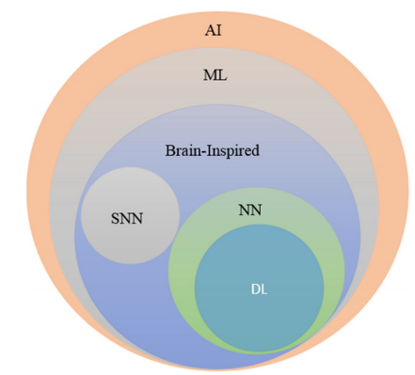
Artificial Intelligence
Next Computing and Engineering Wave
Taxonomy of AI
ML: Machine Learning
NN: Neural Networks
DL: Deep Learning
SNN: Spiking Neural Networks
"A State-of-the-Art Survey on Deep Learning Theory and Architectures", Electronics 2019, 8, 292.
Notes:
When we hear of AI we tend to think of terminator, I-Robot
The fully thinking machine (human like is some way off)
But AI is used in a vast range of narrow specialist areas

Slide 21
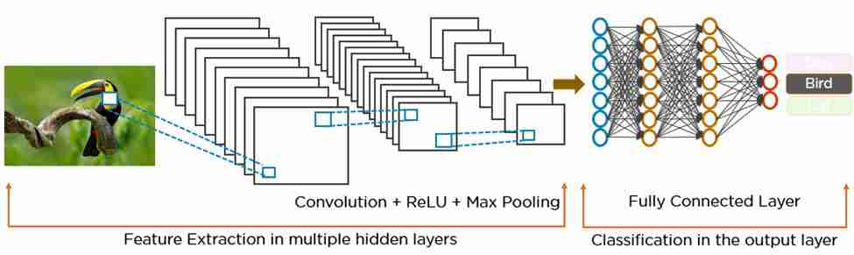
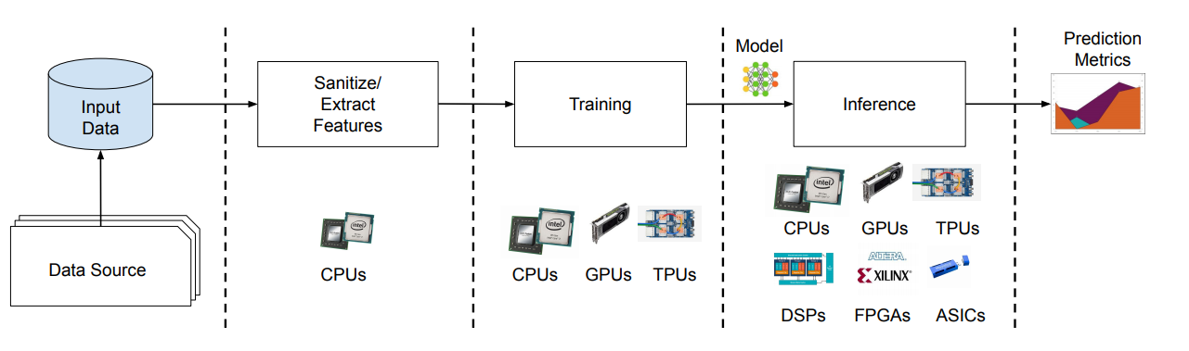
Artificial Intelligence
CNN/DNN – popular in image recognition/speech processing, machine translation.
Source: "Understanding Deep Learning: DNN, RNN, LSTM, CNN and R-CNN" (2019)
Notes:
When we hear of AI we tend to think of terminator, I-Robot
The fully thinking machine (human like is some way off)
But AI is used in a vast range of narrow specialist areas

Slide 22
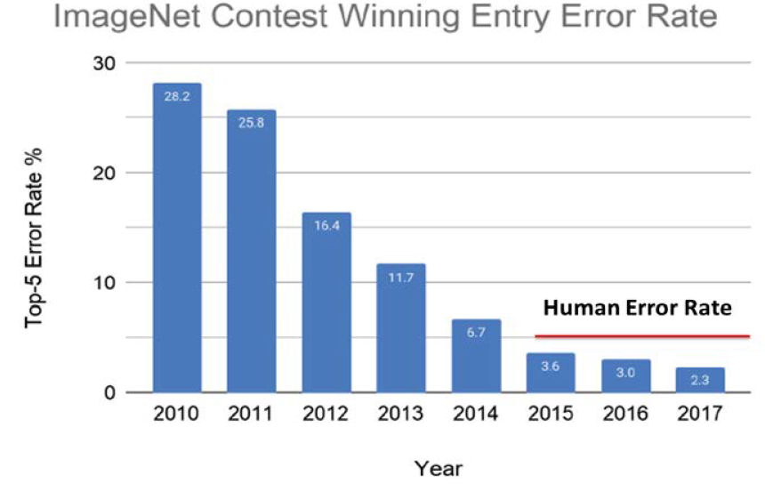
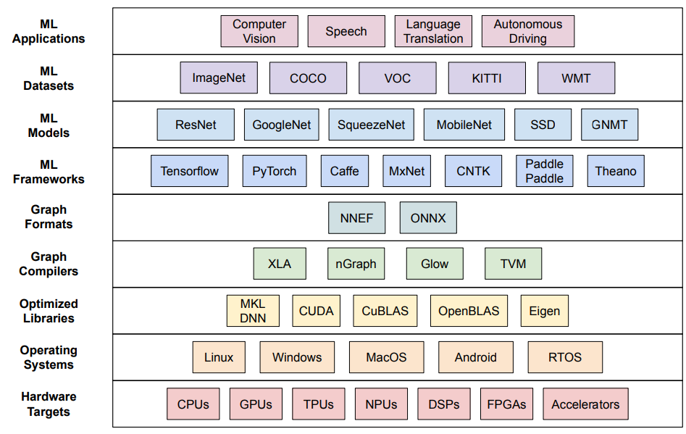
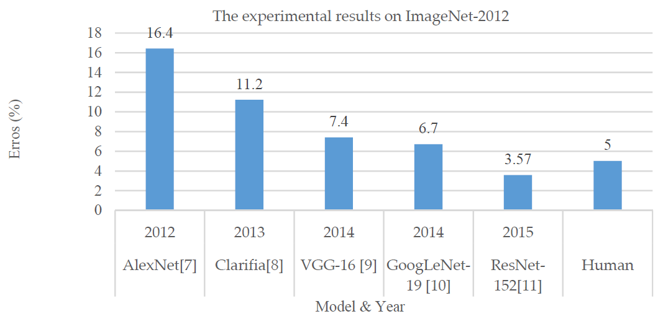
Artificial Intelligence
IEEE International Roadmap for Devices and Systems (IRDS), 2020
Md Zahangir Alom, Electronics, 2019 (doi:10.3390/electronics8030292)
Source: "MLPerf Inference Benchmark“, https://mlperf.org/ (2020)

Slide 23
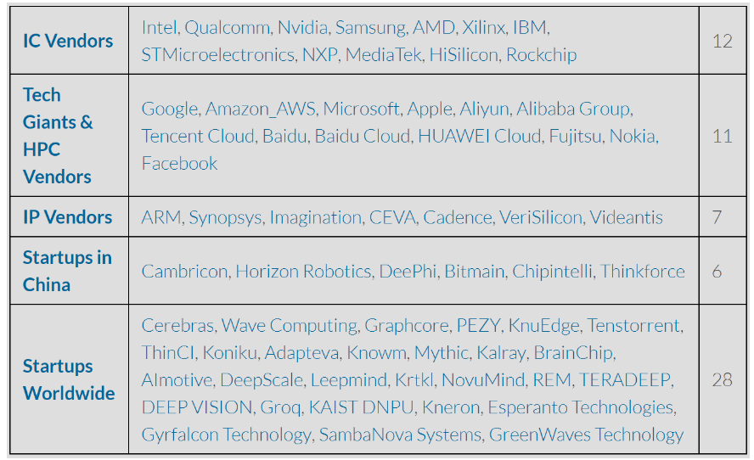
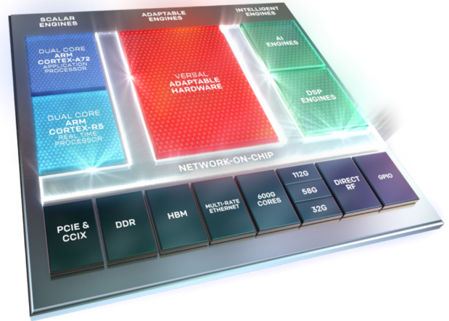


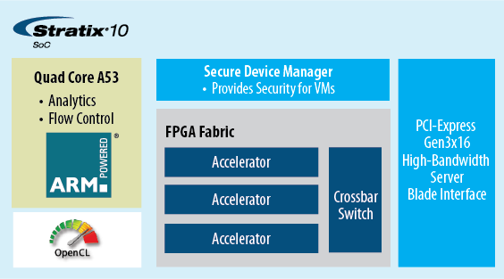
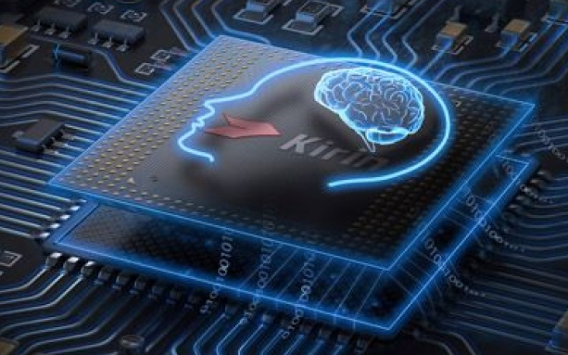
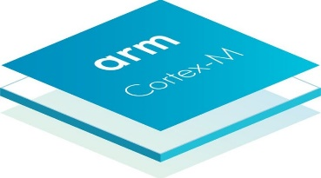
Artificial Intelligence
Embedded AI (Hardware)
Acceleration of network inference and/or training
Low power
Movidius Myriad 2 - Deep learning
Huawei’s Neural Processing Unit (NPU) (Kirin 970)
ARM Ethos-U55 NPU (Edge AI - CortexM55)
Google Pixel Neural Core (Google Pixel)
Qualcomm Hexagon DSP (AI Engine\Snapdragon 865)
Habana Labs Gaudi and Goya neural processors (replaces Nervana)
(2017) https://medium.com/@shan.tang.g/a-list-of-chip-ip-for-deep-learning-48d05f1759ae
Xilinx/Altera FPGAs
Notes:
When we hear of AI we tend to think of terminator, I-Robot
The fully thinking machine (human like is some way off)
But AI is used in a vast range of narrow specialist areas

Slide 24
Artificial Intelligence
Embedded AI (Hardware)
Acceleration of network inference and/or training
Low power
Movidius Myriad 2 - Deep learning
Huawei’s Neural Processing Unit (NPU) (Kirin 970)
ARM Ethos-U55 NPU (Edge AI - CortexM55)
Google Pixel Neural Core (Google Pixel)
Qualcomm Hexagon DSP (AI Engine\Snapdragon 865)
Habana Labs' Gaudi and Goya neural processors (replaces Nervana)
(2017) https://medium.com/@shan.tang.g/a-list-of-chip-ip-for-deep-learning-48d05f1759ae
New kids on the blocks.
Cerebras (CS-1) process ~1.2 terabytes of data per second
Graphcore ( Colossus GC2) x100 over CPU/GPU
Groq (Tensor Stream Processor) 250 trillion FLOPS
Hailo (Hailo-8) penny-sized + outperformed Nvidia’s Xavier AGX
Syntiant (NDP100\NDP101) 140 µW x20 throughput over low-power MCUs
Tenstorrent (Grayskull)
Xilinx/Altera FPGAs
Notes:
When we hear of AI we tend to think of terminator, I-Robot
The fully thinking machine (human like is some way off)
But AI is used in a vast range of narrow specialist areas

Slide 25
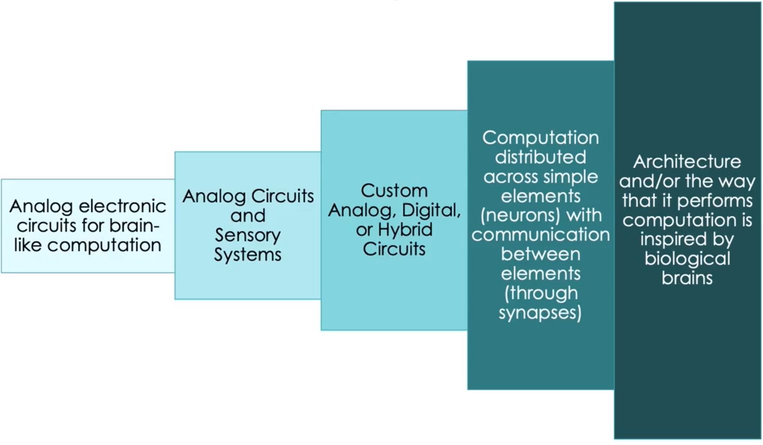
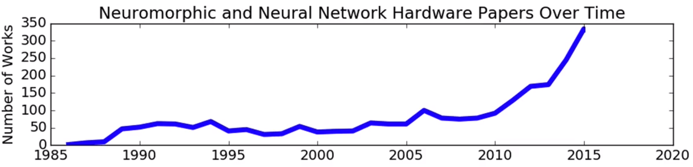
Artificial Intelligence
Neuromorphic Computing?
Carver Mead “Neuromorphic electronic systems” (1990)
Much lower power
Image: Oak Ridge Labs (2020)
1990
1990-mid
2000’s
Late 2000/2010
Present
Catherine Schuman, "NEUROMORPHIC COMPUTING: PAST, PRESENT, AND FUTURE", DATE 2020
Notes:
When we hear of AI we tend to think of terminator, I-Robot
The fully thinking machine (human like is some way off)
But AI is used in a vast range of narrow specialist areas

Slide 26
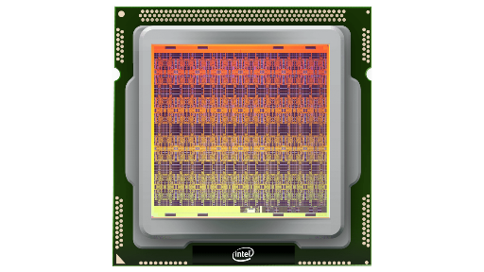
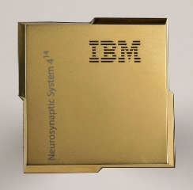


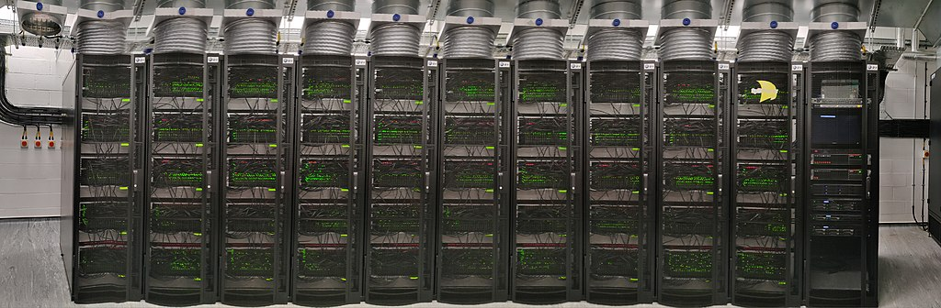
Artificial Intelligence
Neuromorphic Computing?
Intel’s neuromorphic computing (Loihi) 130 million synapses (x1,000 speedup/CPU) On-chip learning.
IBM Neural network processors (TrueNorth) 4,096 core, 256 million synapses
University of Manchester (SpiNNaker)
Heidelberg University (BrainScaleS)
∼ 10¹¹ neurons
∼ 10¹⁵ synapses
Speedup >1,000 biological time
Notes:
When we hear of AI we tend to think of terminator, I-Robot
The fully thinking machine (human like is some way off)
But AI is used in a vast range of narrow specialist areas

Slide 27
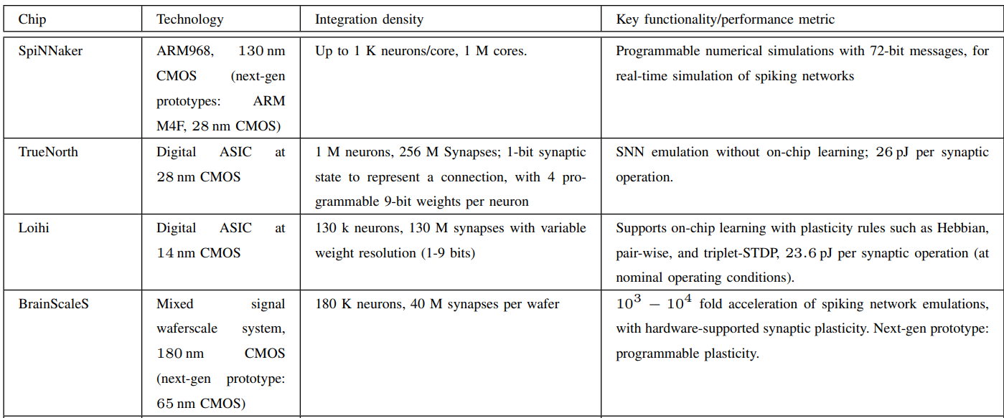
Artificial Intelligence
Neuromorphic Computing?
Intel’s neuromorphic computing (Loihi) 130 million synapses (x1,000 speedup/CPU) On-chip learning.
IBM Neural network processors (TrueNorth) 4,096 core, 256 million synapses
University of Manchester (SpiNNaker)
HeidelBerg University (BrainScaleS)
Speedup >1,000 biological time
Bipin Rajendran, "Low-Power Neuromorphic Hardware for Signal Processing Applications", IEEE Signal Processing Magazine 36(6) Nov. 2019
Notes:
When we hear of AI we tend to think of terminator, I-Robot
The fully thinking machine (human like is some way off)
But AI is used in a vast range of narrow specialist areas

Slide 28
Artificial Intelligence
Neuromorphic Computing?
Intel’s neuromorphic computing (Loihi) 130 million synapses (x1,000 speedup/CPU) On-chip learning.
IBM Neural network processors (TrueNorth) 4,096 core, 256 million synapses
University of Manchester (SpiNNaker)
HeidelBerg University (BrainScaleS)
GrAI Matter Labs (GrAI One) 35mW @ 25 MHz, 200K neurons
BrainChip (SoC Akida) 1.2 million neurons + 10 billion synapses
Speedup >1,000 biological time
Bipin Rajendran, "Low-Power Neuromorphic Hardware for Signal Processing Applications", IEEE Signal Processing Magazine 36(6) Nov. 2019
Notes:
When we hear of AI we tend to think of terminator, I-Robot
The fully thinking machine (human like is some way off)
But AI is used in a vast range of narrow specialist areas

Slide 29

Artificial Intelligence
Are we there yet?
Some way to go
Current AI – had IQ of a 6 year old!
Feng Liu et al. “Intelligence Quotient and Intelligence Grade of Artificial Intelligence” (2016). Carried out tests ranking Google’s AI IQ at 47.2, just shy of the average IQ of a 6-year-old.
Notes:
When we hear of AI we tend to think of terminator, I-Robot
The fully thinking machine (human like is some way off)
But AI is used in a vast range of narrow specialist areas

Slide 30


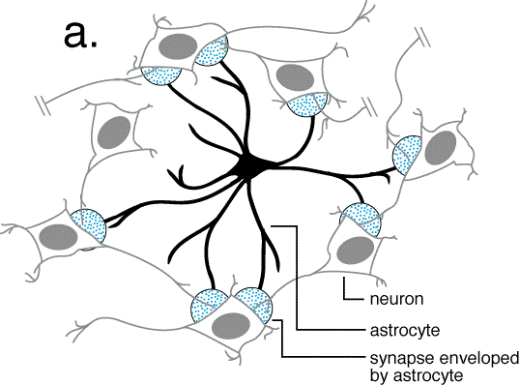
Unmet Need
We can learn a lot from biology, in particular neuroscience!
Brain processing : robust and power-efficient information computing.
Look to mimic fault-tolerant capability of the human brain (to a degree) to build reliable computing hardware.
Brain employs a massively parallel computational network comprising of ∼ 10¹¹ neurons and ∼ 10¹⁵ synapses.
Exploit the brain’s self-repair mechanism (astrocyte cells)
Aim to develop astrocyte-neuron networks……. “Self-rePAiring spiking Neuron NEtwoRk” (SPANNER)

Slide 31

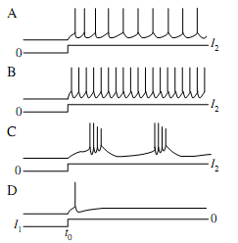
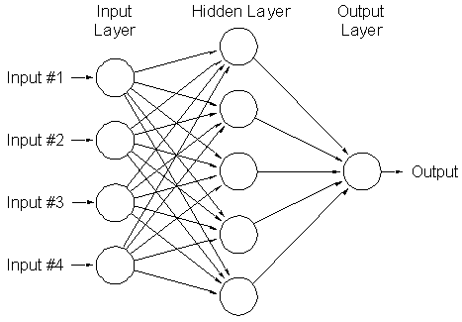
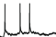
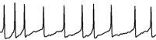
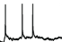
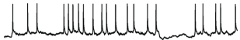

Brain-Inspired Data Processing
Spiking neural network (SNN) a more biologically plausible model of the brain – a neural computing paradigm.
Data
representation
Reads I/P patterns and classifies with an O/P pattern
Input
Output

Slide 32
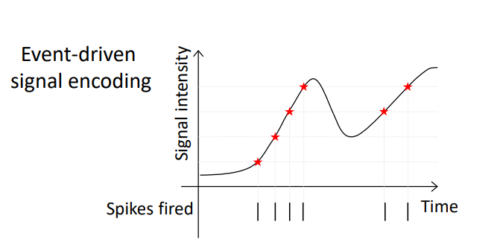
Brain-Inspired Data Processing
Spiking neural network (SNN) a more biologically plausible model of the brain – a neural computing paradigm.
Data
representation
Reads I/P patterns and classifies with an O/P pattern
Input
Output

Slide 33
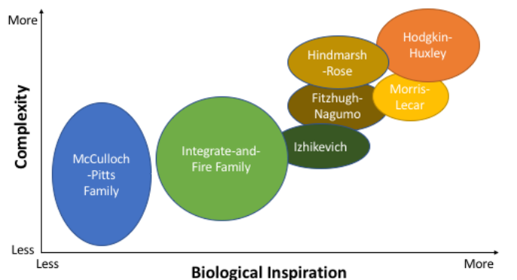
Brain-Inspired Data Processing
Data
representation
Spiking neural network (SNN) a more biologically plausible model of the brain – a neural computing paradigm.
CD Schuman, "A survey of neuromorphic computing and neural networks in hardware", 2017
Reads I/P patterns and classifies with an O/P pattern
Input
Output

Slide 34
Reliability Challenge
Brain-inspired Hardware
Brain-inspired Information Processing
Reliability via Self-repair (the concept)
Building Self-repairing Hardware
On-chip Communication Challenge and NoC Solution
The Opportunities

Slide 35
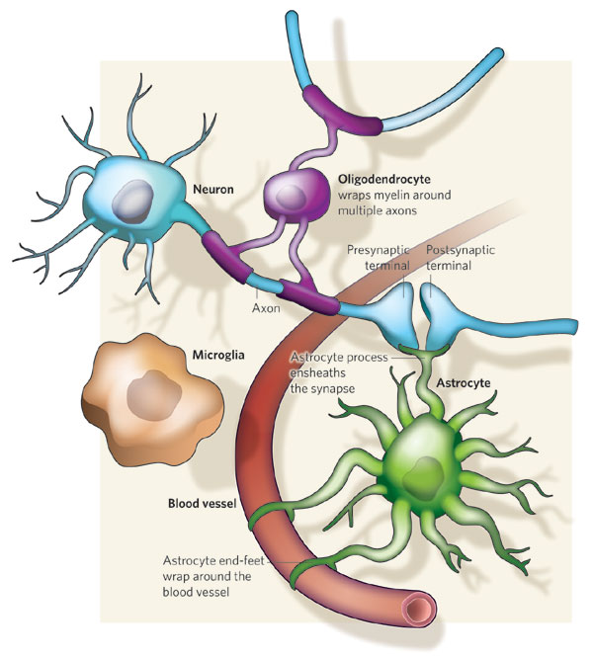
More Knowledge on Brain Repair
Astrocyte enwraps many (~10⁵) synapses and can connect to multiple (~6-8) neighbouring neurons.
The connection between the astrocyte and neurons is named the tripartite synapse.
When an action potential (AP) arrives at the presynaptic axon how do we describe the interactions between the neurons, synapses and astrocyte?
Astrocyte-Neuron (AN) Model
Nicola J. Allen & Ben A. Barres, "Glia — more than just brain glue," Nature, vol. 457, 675-677, 2009. doi:10.1038/457675a

Slide 36
More Knowledge on Brain Repair
Astrocyte enwraps many (~10⁵) synapses and can connect to multiple (~6-8) neighbouring neurons.
The connection between the astrocyte and neurons is named the tripartite synapse.
When an action potential (AP) arrives at the presynaptic axon how do we describe the interactions between the neurons, synapses and astrocyte?
Astrocyte-Neuron (AN) Model
2
1
3
Nicola J. Allen & Ben A. Barres, "Glia — more than just brain glue," Nature, vol. 457, 675-677, 2009. doi:10.1038/457675a

Slide 37
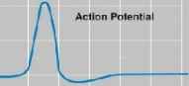



Software Model (AN) - A tripartite synapse story
Action potential (Spike) - presynaptic axon
Indirect feedback (e-SP)
Increasing the PR
Neuro-transmitter (Glutamate) is released across the cleft and binds to the receptors of the postsynaptic terminal.
1
Ca²⁺
Direct feedback (DSE)
Decreasing the PR
After depolarization of postsynaptic neuron, a type of endocannabinoid (2-AG) is synthesized and released from dendrite. 2-AG feeds back to the pre-synaptic terminal in two ways:
Endoplasmic Reticulum (ER)
Glu
Indirect F\B
(+)
Direct F\B
(-)
Probability
of
Release
(PR)
IP₃
Directly
2-AG binds directly to the type 1 Cannabinoid Receptors (CB1Rs) of the presynaptic terminal.
Indirectly
2-AG binds to CB1Rs of the astrocyte cell.
2-AG
Glu
2-AG
Increasing the IP₃ level
3
Triggers the release of calcium (Ca²⁺)
2
This causes a decrease of transmission probability rate (PR) of the synapses, and is termed Depolarization-induced Suppression of Excitation (DSE).
Releases the glutamate (Glu) and binds to the receptors in the synapse
Termed e-SP, this results in an increase of synapse probability of release (PR).
J. Wade, L. McDaid, J. Harkin, et. al, “Self-Repair in a Bidirectionally Coupled Astrocyte-Neuron (AN) System based on Retrograde Signalling,” Frontiers in Computational Neuroscience, 6(76), pp. 1–12, 2012.

Slide 38
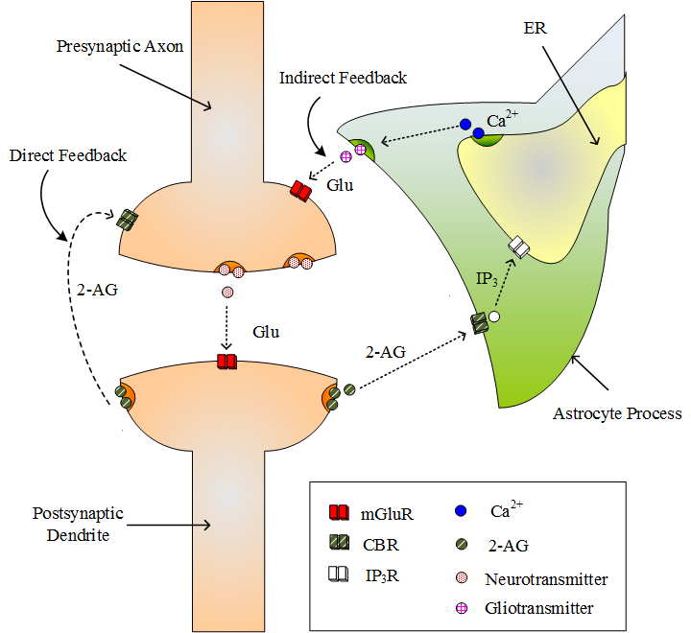
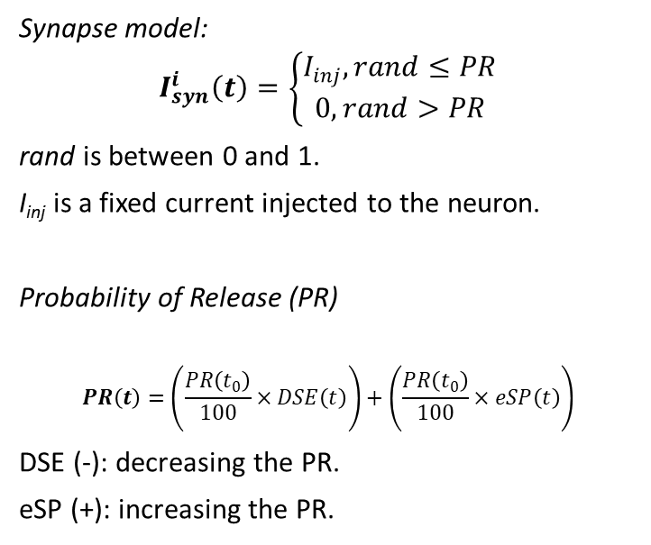
Probability of Release
Synapse model:
$$I_{syn}^{i}\left(t\right)=\left\{\begin{aligned}I_{inj}, rand≤PR \\ 0, rand>PR\end{aligned}\right.$$
rand is between 0 and 1.
I_{inj} is a fixed current injected to the neuron.
Probability of Release (PR)
$$PR\left(t\right)=\left(\frac{PR\left(t_{0}\right)}{100}×DSE\left(t\right)\right)+\left(\frac{PR\left(t_{0}\right)}{100}×eSP\left(t\right)\right)$$
DSE (-): decreasing the PR.
eSP (+): increasing the PR.
J. Wade, L. McDaid, J. Harkin, et. al, “Self-Repair in a Bidirectionally Coupled Astrocyte-Neuron (AN) System based on Retrograde Signalling,” Frontiers in Computational Neuroscience, 6(76), pp. 1–12, 2012.

Slide 39
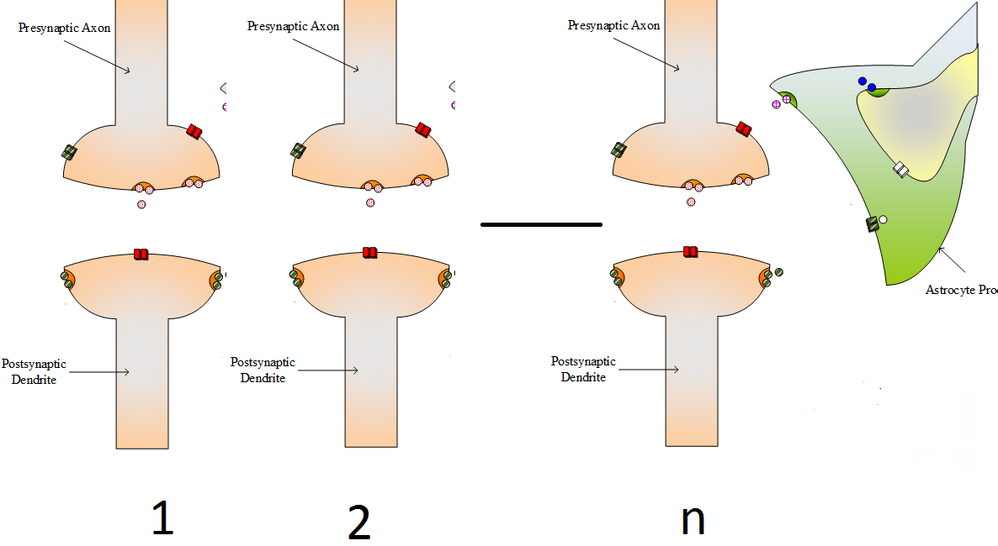

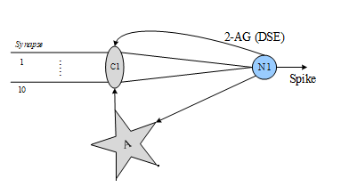
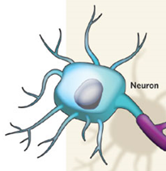
The Bigger Picture - “Astro-Neuron Network”
Action potential - presynaptic axon
(Calcium signal broadcast) IP₃
Many synapses to one Astrocyte
Neuro-transmitter (Glutamate) is released across the cleft and binds to the receptors of the postsynaptic terminal.
After depolarization of postsynaptic neuron, a type of endocannabinoid (2-AG) is synthesized and released from dendrite. 2-AG feeds back to the pre-synaptic terminal in two ways:
Multiple synapses
Directly
2-AG binds directly to the type 1 Cannabinoid Receptors (CB1Rs) of the presynaptic terminal.
Indirectly
2-AG binds to CB1Rs of the astrocyte cell.
J. Wade, L. McDaid, J. Harkin, et. al, “Self-Repair in a Bidirectionally Coupled Astrocyte-Neuron (AN) System based on Retrograde Signalling,” Frontiers in Computational Neuroscience, 6(76), pp. 1–12, 2012.

Slide 40

The Bigger Picture - “Astro-Neuron Network”
Action potential - presynaptic axon
(Calcium signal broadcast) IP₃
Many synapses to one Astrocyte
Neuro-transmitter (Glutamate) is released across the cleft and binds to the receptors of the postsynaptic terminal.
PR+
PR=0
PR+
After depolarization of postsynaptic neuron, a type of endocannabinoid (2-AG) is synthesized and released from dendrite. 2-AG feeds back to the pre-synaptic terminal in two ways:
Multiple synapses
Directly
2-AG binds directly to the type 1 Cannabinoid Receptors (CB1Rs) of the presynaptic terminal.
Indirectly
2-AG binds to CB1Rs of the astrocyte cell.
J. Wade, L. McDaid, J. Harkin, et. al, “Self-Repair in a Bidirectionally Coupled Astrocyte-Neuron (AN) System based on Retrograde Signalling,” Frontiers in Computational Neuroscience, 6(76), pp. 1–12, 2012.

Slide 41
Self-repair of a ‘Small’ Astrocyte-Neuron Network
Faults (PR=~0)
Temporary Faults injected
PR of Synapse #1
Neuron #2 under 80% fault rate with temporary faults.
(80% - severely damaged)
PR of Synapse #10
Naeem M, McDaid L, Harkin J, Wade J, Marsland J, “On The Role of Astroglial Syncytia in Self-Repairing Spiking Neural Networks”, IEEE Transactions Neural Networks & Learning Systems, 2015.

Slide 42
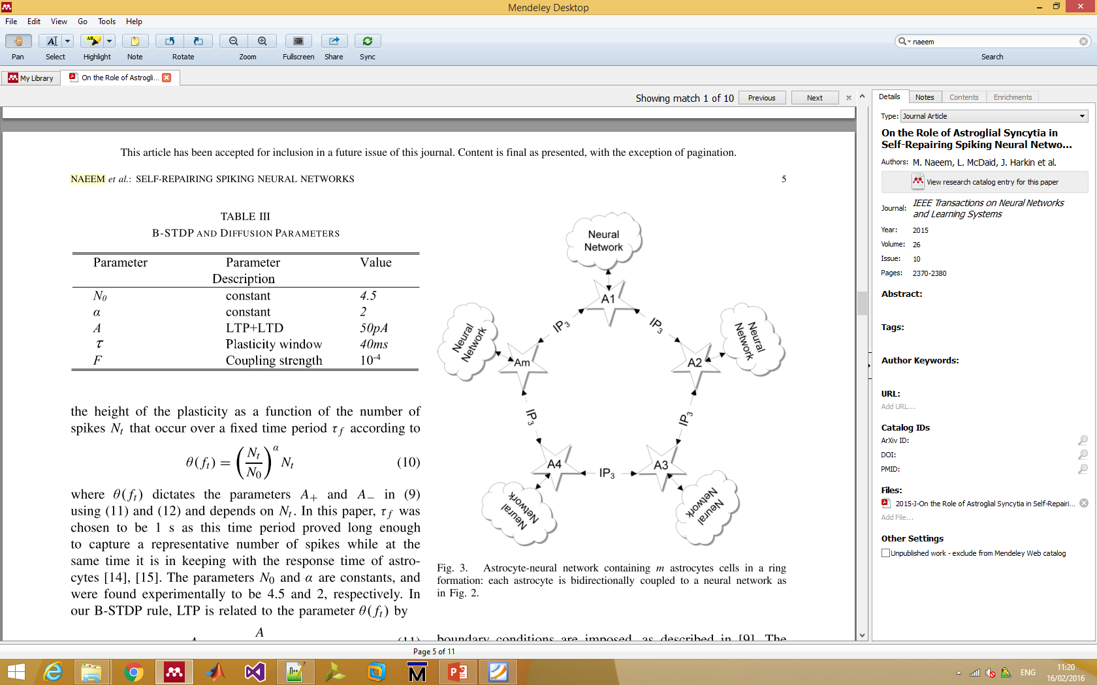
Self-repair of a ‘Small’ Astrocyte-Neuron Network
Faults (PR=~0)
Temporary Faults injected
PR of Synapse #1
Neuron #2 under 80% fault rate with temporary faults.
(80% - severely damaged)
PR of Synapse #10
Naeem M, McDaid L, Harkin J, Wade J, Marsland J, “On The Role of Astroglial Syncytia in Self-Repairing Spiking Neural Networks”, IEEE Transactions Neural Networks & Learning Systems, 2015.

Slide 43
The Bigger Picture - “Astro-Neuron Network”
Astrocytes are the key player in how brain performs distributed repair.
What do Astrocyte-neuron networks afford?
Increased reliability via:
Fine-grained repair at synapse-level
Distributed repair mechanism (astrocyte cell)
New type of neural network paradigm?

Slide 44
Goal and Challenges
Tool-chain
Inter-connect
Blocks
Goal - Effectively map astrocyte-neuron networks to hardware (i.e. reliability via self-repair).
Model real applications: Larger networks.
Key functional blocks: Astrocyte, tri-partitie synapse and learning rule (trade-off computational complexity for key principle with area/power efficiency)
On-chip interconnect: High levels of connections, different time scales, different data – spike events, numeric data values (increased interconnect problem due to astrocyte connections – scalability solutions required)
Tool-chain: Tools to map application to network paradigm, program the hardware, fault injection, data analysis and visualisation.

Slide 45
Reliability Challenge
Brain-inspired Hardware
Brain-inspired Information Processing
Reliability via Self-repair (the concept)
Building Self-repairing Hardware
On-chip Communication Challenge and NoC Solution
The Opportunities

Slide 46
Proof-of-Principle: Moving to Hardware
First-principle computer model of brain-like repair (Astrocyte-neuron Networks).
Explored the mapping to hardware as it enables repairs to achieved when the underlying hardware is unreliable.

Slide 47
SPANNER: Moving to Hardware
e-SP
Astrocyte facility
DSE
2-AG
e-SP
2-AG
Current
Synapse facility
Neuron facility
DSE

Slide 48
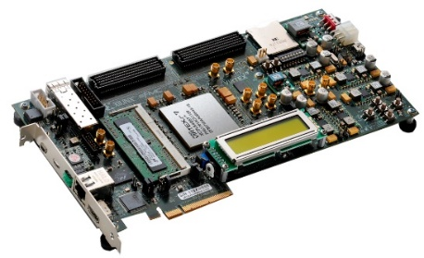
FPGA Hardware Implementation
Neuron #1
Astrocyte-neuron network with 2 neurons (N1, N2), 20 synapses (C1, C2), and 1 astrocyte cell (A).
Xilinx Virtex-7 XC7VX485T
Vivado High Level Synthesis tool to generate the IP blocks
Neuron #2
Xilinx VC707 development board

Slide 49
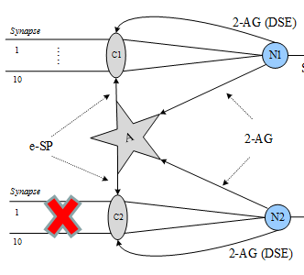
‘Small’ Astrocyte-Neuron Network to FPGAs
1 astrocyte, 2 neurons (20 synap.)
Xilinx Virtex-7 XC7VX485T
Neuron #1
(blue)
Neuron #2
(red)
Liu J, Harkin J, Maguire LP, McDaid L, Wade J; "Self-Repairing Hardware with Astrocyte-Neuron Networks", IEEE International Symposium on Circuits and Systems, Canada (ISCAS), May 23rd-25th, 2016

Slide 50
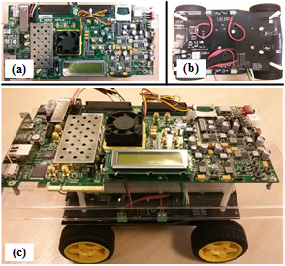
‘Small’ Astrocyte-Neuron Network to FPGAs
1 astrocyte, 2 neurons (20 synap.).
Synapse #1
80% damage injected
Synapse #10
Xilinx Virtex-7 XC7VX485T
Graceful degradation
Neuron #1
(blue)
Neuron #2
(red)
Liu J, Harkin J, Maguire LP, McDaid L, Wade J; "Self-Repairing Hardware with Astrocyte-Neuron Networks", IEEE International Symposium on Circuits and Systems, Canada (ISCAS), May 23rd-25th, 2016

Slide 51
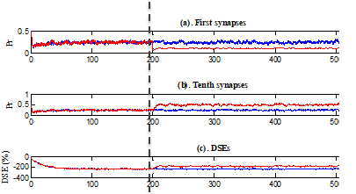
Apply to mobile robotic car
Normal state
Faults injected
IEEE International Symposium on Circuits and Systems, Canada (ISCAS), May 23rd-25th, 2016

Slide 52
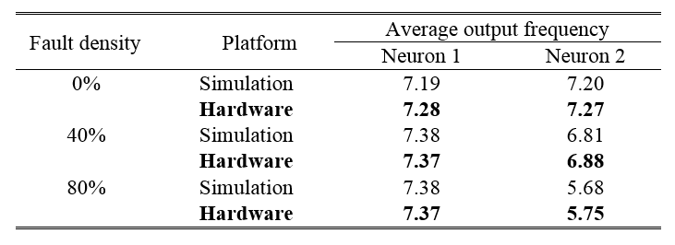

‘Small’ Astrocyte-Neuron Network to FPGAs
Implementation | Time [sec]
Biological neural network | 600
Software simulation | 64
FPGA | 7
Xilinx Virtex-7 XC7VX485T
Liu J, Harkin J, Maguire LP, McDaid L, Wade J; "Self-Repairing Hardware with Astrocyte-Neuron Networks", IEEE International Symposium on Circuits and Systems, Canada (ISCAS), May 23rd-25th, 2016

Slide 53
Challenges
Tool-chain
Inter-connect
Blocks
Model real applications: Larger networks.
Key functional blocks: Astrocyte, tri-partitie synapse and learning rule (trade-off computational complexity for key principle with area/power efficiency)
On-chip interconnect: High levels of connections, different time scales, different data – spike events, numeric data values (increased interconnect problem due to astrocyte connections – scalability solutions required)
Tool-chain: Tools to map application to network paradigm, program the hardware, fault injection, data analysis and visualisation.

Slide 54




Acceleration Platform
Recently dedicated simulation accelerators
GPU Accelerators (NeMo)
Custom Processor accelerators (BrainScales2)
FPGA Accelerators:
We incorporate Astrocyte cell into SNNs i.e. the ability of self-repair.
Therefore, network simulations even more complex.
FPGAs acceleration can reduce the simulation time.
IBM TrueNorth
SpiNNaker 1 Million Cores…
NTU

Slide 55
Key Research Problem
How to implement large-scale accelerators on a multiple FPGA platform and send/receive data from the platform easily ?
Requires the system to achieve:
More area efficient astrocyte cells.
Monitoring and exchanging data with the multiple FPGA platform.
Interconnect (NoC) to channel information (inter/intra FPGA).

Slide 56


Refining Astrocyte Hardware
The Astrocyte model implemented based on original block functions.
Astrocyte hardware is faithful to the original model.
Each block is sub-function in the original model.
Equations belonging to each sub-function were realized using VHDL: 32-bit fixed point (8-bit real, 24-bit fractional).
Differential equations represented using Euler method.
An Euler constant of 0.001 seconds was used.
S. Karim, J Harkin, LJ McDaid et al., “Assessing Self-Repair on FPGAs with Biologically Realistic Astrocyte-Neuron Networks,” Proc. IEEE Computing Society Annual Symposium on VLSI (ISVLSI), July, pp. 421–426, 2017
56

Slide 57




Astrocyte Precision Analysis
Accuracy compared against double float Matlab implementation.
24 bit precision results in more than 10% loss in accuracy.
40-bit precision significantly increases FPGA resource usage without improving accuracy to any degree.
32 bit precision was a reasonable trade-off between resource usage and accuracy..
24-bit
32-bit
S. Karim, J Harkin, LJ McDaid et al., “Assessing Self-Repair on FPGAs with Biologically Realistic Astrocyte-Neuron Networks,” Proc. IEEE Computing Society Annual Symposium on VLSI (ISVLSI), July, pp. 421–426, 2017
57

Slide 58



Fault-injection and Data Monitoring (FMP)
Fault-injection and Data Acquisition Platform for FPGA-based Astrocyte-Neuron Networks
Shvan Karim, Jim Harkin, Liam McDaid, Bryan Gardiner, Junxiu Liu, David M Halliday, Andy M Tyrrell, Jon Timmis, Alan G Millard, Anju P Johnson
"FPGA-based Fault-injection and Data Acquisition of Self-repairing Spiking Neural Network Hardware", IEEE International Symposium on Circuits and Systems (ISCAS) 2018

Slide 59


Fault-injection and Data Acquisition (FMP)
Fault-injection and Data Acquisition Platform for FPGA-based Astrocyte-Neuron Networks
Shvan Karim, Jim Harkin, Liam McDaid, Bryan Gardiner, Junxiu Liu, David M Halliday, Andy M Tyrrell, Jon Timmis, Alan G Millard, Anju P Johnson
"FPGA-based Fault-injection and Data Acquisition of Self-repairing Spiking Neural Network Hardware", IEEE International Symposium on Circuits and Systems (ISCAS) 2018

Slide 60



Experiments on Graceful Degradation
Faults were injected at specific time during the simulation.
Faults severe (reducing PR from 0.5 to zero) or partial (PR 0.5→0.1).
N1 and N2 have the similar avg. O/P frequency up to severe faults injected.
Partial fault
Severe fault
Spiking rate reduces gradually to rates of partial faults.
Spiking rate reduces more steeply to rates of severe faults.
(reducing PR from 0.5 to 0.1)
(reducing PR from 0.5 to zero)
60

Slide 61


Speedup of Network Simulations
Speedup factor between x50 - 65
Communication bottleneck challenge
Acceleration Factor (Matlab Vs FPGA)
If 1 in every 10 samples are recorded - overall simulation and acquisition time will be reduced from around 724 seconds to ~63 seconds.
Under-sampling
Shvan Karim, Jim Harkin, Liam McDaid, Bryan Gardiner, Junxiu Liu, David M Halliday, Andy M Tyrrell, Jon Timmis, Alan G Millard, Anju P Johnson
"FPGA-based Fault-injection and Data Acquisition of Self-repairing Spiking Neural Network Hardware", IEEE International Symposium on Circuits and Systems (ISCAS) 2018

Slide 62
Challenges
Tool-chain
Inter-connect
Blocks
Model real applications: Larger networks.
Key functional blocks: Astrocyte, tri-partitie synapse and learning rule (trade-off computational complexity for key principle with area/power efficiency)
On-chip interconnect: High levels of connections, different time scales, different data – spike events, numeric data values (increased interconnect problem due to astrocyte connections – scalability solutions required)
Tool-chain: Tools to map application to network paradigm, program the hardware, fault injection, data analysis and visualisation.

Slide 63
Reliability Challenge
Brain-inspired Hardware
Brain-inspired Information Processing
Reliability via Self-repair (the concept)
Building Self-repairing Hardware
On-chip Communication Challenge and NoC Solution
The Opportunities

Slide 64

Interconnect Challenge
Large volumes of neurons\astrocytes with different communication requirements:
high speed temporal spike event for the neuron network
low speed numerical inositol trisphosphate (${IP}_{3}$) information exchange for astrocyte network
Astrocyte-neuron network viewed as two-tiered network (neuron and astrocyte networks).

Slide 65


Background: Evolution Timeline
Xilinx Versal FPGA

Slide 66

On-chip Interconnection
Bus-based was Traditional
Wait
Wait
Wait
P1
I/O
2
P2
P3
M1
P4
M2
I/O
1
P5
P6
M3
I/O
3
P7
M4
Wait
Wait
Wait
Notes:
To overcome wiring or interconnect complexity Bus based system was proposed .
It is easy to set up, handle, understand and implement.
It is best-suited for small networks.
while the number of components attached to the bus is increased, a physical capacitance on the bus wires grow.
As a result its wiring delay grows even further causing propagation delays.

Slide 67


Bus-based communication

Slide 68



Introduction to NoC - Basic Components
What is Networks-on-Chip (NoC) ???
New interconnection paradigm that is used to connect electronic systems inside a chip
Why do we need it ???
Number of transistors (Moore’s Law)
Modularity (IP cores + re-used)
Reduce time to market

Slide 69

Networks-on-Chip (NoC)
Mesh Based
Router
Processing Element
Network Interface
Communication Data
Notes:
To overcome the deficiencies of scalability and latency network on chip (NoC) architecture has been adopted. It provides Point-to-point contact between every pair of nodes with bus based wiring system, in which one channel is used by multiple processor. This approach has the tendency to fulfil high performance requirements and it provides the designers with multi-path options to optimize their design according to their requirement.
NoC use routing algorithm to deliver data from source to destination node. an ideal routing algorithm the traffic will be evenly distributed in the network,
Congestion/hotspot is caused by the concentration of traffic in a network area producing a slow-down in data communication while other links are free elsewhere.
The arrangement of the network nodes is such that it is possible to transmit data from one node to many other nodes at the same time
By applying network-like communication which inserts some routers in-between each communication object, the required wiring can be shortened. Therefore, the switch-based interconnection mechanism provides a lot of scalability and freedom from the limitation of complex wiring.

Slide 70
Messaging Units
Data/Message
Packet
Packet
Packet
Packet
Flit
Flit
Flits: flow control digits
Head flit
Tail flit
Phits: physical flow control digits
type
Dest Info
Seq #
misc
Data is transmitted based on a hierarchical data structuring mechanism
Messages → packets → flits → phits
flits and phits are fixed size, packets and data may be variable sized
phit is a unit of data that is transferred on a link in a single cycle
typically, phit size = flit size
70

Slide 71

NoC – Its Abstraction and Challenges
NoC Advantages…
Scalability
Modularity
High level abstraction
NoC Challenges…
Design efficient routers
Hierarchical topologies
Routing Algorithms

Slide 72
NoC Interconnect Scalability
R
R
R
R
R
R
R
R
R
R
R
R
R
R
R
R
R
R
R
8x8 array
R
R
R
R
R
R
R
R
R
R
R
R
R
3x3 array
R
R
R
R
R
R
R
R
R
R
R
R
R
R
R
R
R
R
R
R
R
R
R
R
R
R
R
R
R
R
R
R
R
R
R
R
R
R
R
R
R
R
5x5 array
R
R
R
R
R
R
R
R
R
R
R
R
R
R
R
R
R
R
R
R
R
R
R
R

Slide 73

NoC Concepts
NoC Architecture (a.k.a. NoC router)
Combinational and sequential components
Topology
How the nodes are connected together
Routing Algorithms
Path selection between a source and a destination node in a particular topology
Switching Mechanisms
Allocation of network resources (bandwidth, buffer capacity, …) to information flows
Flow control Mechanisms
How the downstream node communicates forwarding availability to the upstream node

Slide 74
NoC Concepts
NoC Architecture (a.k.a. NoC router)
Combinational and sequential components
Topology
How the nodes are connected together
Routing Algorithms
Path selection between a source and a destination node in a particular topology
Switching Mechanisms
Allocation of network resources (bandwidth, buffer capacity, …) to information flows
Flow control Mechanisms
How the downstream node communicates forwarding availability to the upstream node

Slide 75

Generic NoC Router Architecture
LT
RC
VCA
SA
ST
Link
Router
By using prediction/speculation, pipeline can be made more compact
LT: Link Traversal
RC: Route Computation
VCA: VC Allocation
SA: Switch Allocation
ST: Switch Traversal.

Slide 76
Pipelined Router Microarchitecture
Stage 1
Stage 2
Stage 3
Stage 4
Stage 5
Input buffers
Output buffers
Physical
channel
Physical
channel
CrossBar
Link
Control
Link
Control
Routing Computation
DEMUX
MUX
DEMUX
MUX
Physical
channel
Input buffers
Output buffers
Physical
channel
Link
Control
Link
Control
Routing Computation
DEMUX
MUX
DEMUX
MUX
VC Allocation
Switch Allocation
LT & IB (Input Buffering)
RC
VCA
SA
ST & Output Buffering

Slide 77

NoC Topologies

Slide 78




NoC Topologies
Mesh
Binary-Tree
Torus
Star
Ring
Hybrid

Slide 79

Abstract Metrics: Degree
79

Slide 80


Abstract Metrics: Hop Count
80

Slide 81

Abstract Metrics: Path Diversity
81

Slide 82



Unconventional NoC Topologies
82

Slide 83
NoC Concepts
NoC Architecture (a.k.a. NoC router)
Combinational and sequential components
Topology
How the nodes are connected together
Routing Algorithms
Path selection between a source and a destination node in a particular topology
Switching Mechanisms
Allocation of network resources (bandwidth, buffer capacity, …) to information flows
Flow control Mechanisms
How the downstream node communicates forwarding availability to the upstream node

Slide 84

Taxonomy for Routing Algorithms
Routing algorithm determines the path selection by a packet to reach its destination
A routing algorithm aims to balance traffic loads to maximise throughput of data packets

Slide 85
Static vs. Dynamic Routing
Static routing: fixed paths are used to transfer data between source & destination
does not take into account current state of the network
advantages of static routing:
easy to implement, since very little additional router logic is required
in-order packet delivery if single path is used
Dynamic routing: routing decisions are made according to the current state of the network
considering factors such as availability and load on links
path between source and destination may change over time
as traffic conditions and requirements of the application change
more resources needed to monitor network state and dynamically change routing paths
able to better distribute traffic in a network
85

Slide 86
Example: Static Routing
Static XY routing (commonly used):
a deadlock-free shortest path routing which routes packets in the X-dimension first and then in the Y-dimension.
Used for tori and meshes
Destination address expressed as absolute coordinates
03
13
23
(1,1) – (2,0) ➔ -X
(1,1) – (1,0) ➔ +Y
(1,1) – (1,1) ➔ FD
02
12
22
01
11
21
+y
00
10
-x
20

Slide 87
Example: Adaptive Routing
03
13
23
02
12
22
01
11
21
00
10
20
Chooses shortest path to destination with minimum congestion
Path can change over time
Because congestion changes over time

Slide 88




The Livelock Problem
The Livelock problem !!…
Livelock occurs when a packet travels indeﬁnitely in the network without ever reaching its destination.
Possible solution: a counter !!!

Slide 89
NoC Concepts
NoC Architecture (a.k.a. NoC router)
Combinational and sequential components
Topology
How the nodes are connected together
Routing Algorithms
Path selection between a source and a destination node in a particular topology
Switching Mechanisms
Allocation of network resources (bandwidth, buffer capacity, …) to information flows
Flow control Mechanisms
How the downstream node communicates forwarding availability to the upstream node

Slide 90

Switching Techniques
A switching technique determines the way a packet is transmitted across the network…
The Switching techniques can be classified based on…
Circuit switched networks reserve a physical path before transmitting the data packets.
packet switched networks transmit the packets without reserving the entire path.

Slide 91
Circuit Switching
Setup Time (negotiation)
Buffers
for “request”
tokens
Source
end node
Destination
end node

Slide 92
Circuit Switching
Setup Time (negotiation)
Buffers
for “request”
tokens
Source
end node
Destination
end node
Request for circuit establishment
(routing and arbitration is performed during this step)

Slide 93
Circuit Switching
Setup Time (negotiation)
Buffers
for “ack” tokens
Source
end node
Destination
end node
Request for circuit establishment
Acknowledgment and circuit establishment
(as token travels back to the source, connections are established)

Slide 94
Circuit Switching
Data Transmission
Source
end node
Destination
end node
Request for circuit establishment
Acknowledgment and circuit establishment
Packet transport
(neither routing nor arbitration is required)

Slide 95
Packet Switching
Packets are transmitted from source and make their way independently to receiver
possibly along different routes and with different delays
Zero start up time, followed by a variable delay due to contention in routers along packet path
QoS guarantees are harder to make
Three main packet switching scheme variants:
Store and Forward (SAF) switching
Virtual Cut Through (VCT) switching
Wormhole (WH) switching
95

Slide 96
Packet Switching (Store & Forward)
Buffers
for data
packets
Store
Source
end node
Destination
end node
Packets are completely stored before any portion is forwarded
Message Header
Message Data
Link
t_{r}
t_{packet}
Time Busy

Slide 97
Packet Switching (Store & Forward)
Requirement:
buffers must be
sized to hold
entire packet
(MTU)
Forward
Store
Source
end node
Destination
end node
Packets are completely stored before any portion is forwarded
Message Header
Message Data
Link
t_{r}
t_{packet}
Time Busy

Slide 98
Packet Switching (Virtual Cut-through)
Routing
Source
end node
Destination
end node
Portions of a packet may be forwarded (“cut-through”) to the next switch
before the entire packet is stored at the current switch

Slide 99
Virtual Cut Through vs. Wormhole
Buffers for data
packets
Requirement:
buffers must be sized
to hold entire packet
(MTU)
Virtual Cut Through
Wormhole
Source
Destination
end node
Buffers for flits:
packets can be larger
than buffers
Source
Destination

Slide 100
Virtual Cut Through vs. Wormhole
Buffers for data
packets
Requirement:
buffers must be sized
to hold entire packet
(MTU)
Virtual Cut Through
Wormhole
Busy
Link
Packet completely
stored at
the switch
Destination
end node
Buffers for flits:
packets can be larger
than buffers
Busy
Link
Packet stored
along the path
Source
Destination

Slide 101


Evaluation Metrics
Throughput ➔ frequency operation, number of pipeline stages, etc…
Latency ➔ routing algorithm, switching technique, packet format, etc…
Area Utilisation ➔ buffers, look-up tables, routing engine, CMOS technology etc…
Power Consumption ➔ throughput spec + latency spec + area spec !!!
Trade-Off !!

Slide 102


NoC for Brain Info. Communication?
Hierarchical Astrocyte Network Architecture (HANA)
Hierarchical NoC (H-NoC) for spiking neural network: Neuron, Tile & Cluster levels.
10¹ sec. timescale
10⁻³ sec. timescale
Liu J, Harkin J, McDaid L, Martin G; "Hierarchical NoC Interconnect for Astrocyte-Neuron Network Hardware", 25th Inter. Conf. on Artificial Neural Nets (2016)
Carrillo, S., Harkin, J., McDaid, et. al: “Scalable Hierarchical NoC Architecture for Spiking Neural Network Hardware Implementations”. IEEE Trans. on Parallel and Distributed Systems. (2013)

Slide 103
NoC for Brain Info. Communication?
Hierarchical Astrocyte Network Architecture (HANA)
Hierarchical NoC (H-NoC) for spiking neural network: Neuron, Tile & Cluster levels.
10¹ sec. timescale
10⁻³ sec. timescale
Martin G J, Harkin J, McDaid L et al. "On-chip communication for neuro-glia networks" IET Computers & Digital Techniques, 12(4), pp. 130-138, 7 2018
Carrillo, S., Harkin, J., McDaid, et. al: “Scalable Hierarchical NoC Architecture for Spiking Neural Network Hardware Implementations”. IEEE Trans. on Parallel and Distributed Systems. (2013)

Slide 104
NoC for Brain Info. Communication?
Hierarchical Astrocyte Network Architecture (HANA)
Hierarchical NoC (H-NoC) for spiking neural network: Neuron, Tile & Cluster levels.
10¹ sec. timescale
10⁻³ sec. timescale
Ring topology
Martin G J, Harkin J, McDaid L et al. "On-chip communication for neuro-glia networks" IET Computers & Digital Techniques, 12(4), pp. 130-138, 7 2018
Carrillo, S., Harkin, J., McDaid, et. al: “Scalable Hierarchical NoC Architecture for Spiking Neural Network Hardware Implementations”. IEEE Trans. on Parallel and Distributed Systems. (2013)

Slide 105





NoC Works!
Hierarchical Astrocyte Network Architecture (HANA)
Hierarchical NoC (H-NoC) for spiking neural network: Neuron, Tile & Cluster levels.
Increased throughput under load testing
HNoC router performance
Liu J, Harkin J, McDaid L, Martin G; "Hierarchical NoC Interconnect for Astrocyte-Neuron Network Hardware", 25th Inter. Conf. on Artificial Neural Nets (2016)
Carrillo, S., Harkin, J., McDaid, et. al: “Scalable Hierarchical NoC Architecture for Spiking Neural Network Hardware Implementations”. IEEE Trans. on Parallel and Distributed Systems. (2013)

Slide 106
Reliability Challenge
Brain-inspired Hardware
Brain-inspired Information Processing
Reliability via Self-repair (the concept)
Building Self-repairing Hardware
On-chip Communication Challenge and NoC Solution
The Opportunities

Slide 107
What is Next?
Major potential gains in the provision of adaptive systems that provide high-levels of reliability.
New generation of engineers required to think differently!
Exploring beyond information processing brings new models of reliable computation. Engineering and Neuroscience?
Next big wave in how we design modern embedded systems.

Slide 108





Opportunities
Build new computers that allow Neuroscientists to understand brain diseases (e.g. Parkinson's), pharmaceutical companies design new drugs.
Harsh environments: Robotics in nuclear industry, Wireless sensor networks in environmental disasters; forest fire, structural health monitors (earthquake damage).
Remote locations: Border security, Space, Deep sea
Error resilience in computing: Plastic electronics, robotics, modern microprocessors

Slide 109
Opportunities
Build new computers that allow Neuroscientists to understand brain diseases (e.g. Parkinson's), pharmaceutical companies design new drugs.
Harsh environments: Robotics in nuclear industry, Wireless sensor networks in environmental disasters; forest fire, structural health monitors (earthquake damage).
Remote locations: Border security, space, deep sea
Error resilience in computing: Plastic electronics, robotics, modern microprocessors.
Augment existing architectures – not replace!
???

Slide 110





Take Home Message
Embedded AI - many challenges remaining
Astrocyte Neuron systems - Disruptive approach
Major potential gains in the provision of adaptive systems that provide high-levels of reliability
Feasibility shown for establishing future development
Computational Neuroscience and Neuromorphic Engineering Team
Modelling: Prof. L McDaid, Dr J Wade Dr B Flanagan (A Reza, D Harkin)
Hardware: Dr J Harkin, Dr J Liu, M. McElholm, Dr G Martin (A Javid, D Simpson, N Hamilton, K Madden)
Human Frontiers Science Programme
EPSRC SPANNER project (EP/N00714X/1)

Slide 111
Thank You
Modelling: Prof. L McDaid, Dr J Wade Dr B Flanagan (A Reza, D Harkin)
Hardware: Dr J Harkin, Dr J Liu, M. McElholm, Dr G Martin (A Javid, D Simpson, N Hamilton, K Madden)
Human Frontiers Science Programme
EPSRC SPANNER project (EP/N00714X/1)

